Slide 1

Number talks
Notes:
Presenter Introductions
Say: We are so glad to be here with you today to give you an overview of using Number Talks effectively in your classroom. The beginning of our presentation will be dedicated to providing an overview of the purpose and structures of Number Talks. Once we have covered the basics, we will begin to look at HOW to implement it and what it looks like in your classrooms from Kindergarten to 5th Grade.
(1 min.)

Slide 2
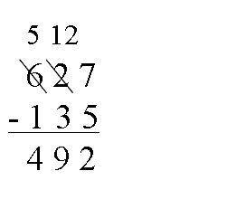
Something to ponder…
“Our classrooms are filled with students and adults who think of mathematics as rules and procedures to memorize without understanding of numerical relationships that provide the foundations of these rules.”
-Quote from 1919
Number Talks
How has your math instruction changed?
Notes:
Say: Please read the quote on the screen and think about the relevance this quote has in today’s math instruction.
<click for OLD SCHOOL problem solving example>
<Click to display question.>
Say: How has your instruction in math changed as a result of the Common Core standards?
Share out.
(2 min.)

Slide 3
Shift in thinking…
Calculate this problem mentally.
Be prepared to share your strategies aloud.
17 + 25
©2007 Math Perspectives.
Notes:
Say: Let’s see how our thinking has shifted when solving math problems. Calculate this problem mentally. Be prepared to share your strategies aloud.
(Give think time)
Say: Raise your hand if you have an answer. (Retrieve possible answers).
Great! Now that we have a possible answers, let’s hear your strategies for solving this problem.
(Share strategies)
(4 min)

Slide 4
Why Number Talks ?
Develop efficient, flexible, and accurate computation strategies
Built on key foundational ideas of mathematics
Promote discourse
Develop number sense
Helps kids understand math!
Notes:
Read and elaborate on the slide components.
Say: It is important to understand that number talks are not a “program.” They are implemented to help support the standards you are already teaching in your classrooms. Number talks align with the NEPF as well as the 8 Standards for Mathematical Practices, which we will discuss later this morning. As a rule, limit number talks to 5-15 minutes in length.
(1 min.)

Slide 5
Key Components
Classroom Environment & Community
Classroom Discussions
The Teacher’s Role
The Role of “Mental Math”
Purposeful Computation Strategies
Notes:
Classroom Environment & Community:
According to Number Talks, “building a cohesive classroom community is essential for creating a safe, risk-free environment for number talks. The classroom culture should be based on acceptance and the common quest for learning and understanding.”
Classroom Discussions:
Students are encourages to share their strategies, respond to others’ strategies, and justify their reasoning.
The Teacher’s Role:
Number Talks allow the teacher to help students make sense of mathematics. We do this by taking the role of a facilitator, questioner, listener, and learner.
The Role of Mental Math:
When students are asked to solve problems without paper and pencil, “they are encouraged to rely on what they know and understand about numbers and how they are interrelated.” (p. 13) Mental math helps students focus on number relationship and develop strategies to solve problems with computational fluency.
Purposeful Computation Strategies:
According to Number Talks, “The teacher’s goals and purposes for the number talk should determine the numbers and operations that are chosen.” It is essential to plan number talks ahead of time to ensure you are designing problems that are “just right.”
(5 min.)

Slide 6
The 4 Essentials
Location
Wait Time
Acceptance
Communication
Notes:
Say: Establishing the following procedures and expectations are essential to the success of effective Number Talks.
Location
Select a designated location that allows you to maintain close proximity to your students for informal observations and interactions.
2. Wait Time:
Provide appropriate wait time for the majority of students to access the problem.
3. Acceptance
Accept, respect, and consider all answers. This must be explicitly modeled.
4. Communication
Encourage student communication throughout the Number Talk. Consider sentence frames or other conversational strategies.
(1 min.)

Slide 7

What are the steps of Number talks?
Notes:
Say: There are a set of steps to follow when conducting a Number Talk. We will walk through each step to give you an idea of what it looks like in a classroom. Then, we will watch some real classroom examples.
Pass out Number Talks steps posters.
(less than 1 min.)

Slide 8
STEP 1
Teacher presents the problem.
Notes:
Say: Let’s practice as if you all were the students.
Read slide and click to the next slide to present the problem.
(10 seconds)

Slide 9
223 +129
Notes:
Say: It is completely up to the teacher whether to present the problem on chart paper, or the Promethean board. You can read the problem to the students.
(1 min.)

Slide 10
STEP 2
The students think of an answer.
Notes:
Read slide
Click to problem again.
(5 seconds)

Slide 11
223 +129
Notes:
Say: Please solve the problem mentally.
Give the participants a few minutes to solve the problem mentally.
(3-4 min.)

Slide 12
STEP 3
Put your thumb up by your chest when you have an answer.
223 +129
Notes:
Read slide
Say: This action lets the teacher know students have solved the problem mentally and are ready to share strategies.
(30 seconds)

Slide 13
STEP 4
Teacher will collect answers from students willing to share.
223 +129
Notes:
Read slide
Say: At this point, students will raise their hand if they want to share. Would anyone like to share their answers?
Record possible answers on the board/chart paper. Accept all answers.
(1 min.)

Slide 14
STEP 5
Students share their strategies as the teacher scribes. Teacher asks clarifying/probing questions.
223 +129
Notes:
Read slide
Say: Now that your students have shared possible answers, they would be asked to share their strategies. So you might say, “Ok, now that we have a possible answer(s), who would like to share their strategies?”
Say: As the students share their strategy, the teacher will scribe their thinking and ask clarifying/probing questions if needed.
Pick a participant or 2 to share their strategy, while the presenter scribes.
Say: Those are the five steps to completing number talks. Any questions?
(6-7 min.)

Slide 15
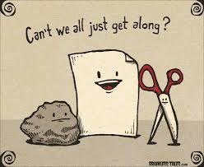
Body Rock, Paper, Scissors
Notes:
Say: You are probably all ready for a BRAIN BREAK after all that information! We’d like to teach you a new BRAIN BREAK today called “Body Rock, Paper, Scissors.” Basically it’s a game of rock, paper, scissors, but using body movements instead of just hand movements. Please stand up and push in your chairs.”
<Presenters will show the audience the movement for rock (crouch down), paper (hands out star), scissors (split legs).>
Say: Find a partner and try best of out 3 for BODY Rock, Paper, Scissors.
(3 min)

Slide 16
Kindergarten
Frames & Dot Cards
K.OA.A.3
Discuss with your table:
What was the teacher’s role in the number talk?
What features would you like to see in your classroom?
Notes:
Say: For the next portion of our presentation, we will be watching some videos of actual Number Talks in each grade level. While watching, we would like you to jot down some notes on your notes page. We will discuss our observations after each video.
<Pass out notes page>
Play Kindergarten Clip K.1 – 10 Frames and Dot Cards (5:38)
<Click to reveal discussion questions.>
Say: Please discuss the questions on the slide with your table. (1 min.)
Share out (1 min.)
Total Time (8-9 min)

Slide 17
1st Grade
Ten Frames
1.OA.A.1
Discuss with your table:
What were the differences and similarities were there between this number talk and the Kinder one?
Notes:
Say: We will now look at an example of a first grade number talk.
Play Second Grade Clip 2.1 – 10 Frames 8+6 (4:40)
<Click to reveal discussion questions.>
Say: Please discuss the questions on the slide with your table. (1 min.)
Share out (1 min.)
Total Time (7-8 min.)

Slide 18
2nd Grade
Addition
2.OA.A.1
Discuss with your table:
What supports did the teacher use to help the students solve the problem?
Notes:
Say: We will now look at an example of a second grade number talk.
Play Second Grade Clip 2.3 – 26 + 27 (2:10)
<Click to reveal discussion questions.>
Say: Please discuss the questions on the slide with your table. (1 min.)
Share out (1 min.)
Total Time (4-5 min.)

Slide 19
3rd Grade
Doubling and Halving
3.OA.A.1
Discuss with your table:
What different strategies did the students use to solve the problem?
Notes:
Say: We will now look at an example of a third grade number talk.
Play Third Grade Clip 3.6 – 4 x 7, 2 x 14 (5:38)
<Click to reveal discussion questions.>
Say: Please discuss the questions on the slide with your table. (1 min.)
Share out (1 min.)
Total Time (6-7 min.)

Slide 20
4th Grade
Partial Products
4.NBT.B.5
Discuss with your table:
What happened when a student got the wrong answer?
What routines did you see evident?
Notes:
Say: We will now look at an example of a fourth grade number talk. As seen in the preview, Diana is conducting a number talk with her students highlighting the “partial products” strategy. Diana is a second year teacher who has embraced number talks in her classroom.
Play Diana video – GO TO PZ12.ORG to ACCESS VIDEO – UNDER RESOURCES>MATH
3 x 26, 6 x 26, 9 x 26 (6 min.)
<Click to reveal discussion questions.>
Say: Please discuss the questions on the slide with your table. (1 min.)
Share out (1 min.)
Total Time (10 - 12 min.)????? (depends on length of Diana’s video)

Slide 21
5th Grade
Doubling & Halving
5.NBT.B.5
Discuss with your table:
How did the students’ strategies differ in solving this problem?
Notes:
Say: Lastly, we will now look at an example of a fifth grade number talk.
Play Fifth Grade Clip 5.3 – 16 x 35 (3:48)
<Click to reveal discussion questions.>
Say: Please discuss the questions on the slide with your table. (1 min.)
Share out (1 min.)
Total Time (4 min.)

Slide 22

Needs
N
W
E
S
Compass Points
Excitements
Worries
Stance, Steps, or Suggestions
Notes:
Say: Before we take a well-deserved break, we would like to hear your thoughts regarding number talks. The structure we will use in called “Compass Points.” It is a routine for exploring ideas from the book Making Thinking Visible. This activity allows groups of learners to consider an idea or proposition from different angles. By exploring issues from multiple perspectives and identifying areas where more information is needed, individuals can avoid rushing to judgment.
To set this up for students, you place chart paper, one for each compass point, around the room. Lavel them with one of the letters denoting the compass points. Distribute sticky notes for students to write their ideas on.
Say: Before going on break, please consider your excitements about using number talks, your worries about implementing them, your needs in order to be successful, and your stance on the idea, steps you will take, or suggestions for teachers. After contributing a sticky note for each compass point, feel free to take a break and be back by ____________. Give about 20 minutes for whatever time it is on the clock right now. (5 min for stickies, 15 min for break).

Slide 23

Notes:
5 min. for completing stickies
15 min for break!

Slide 24
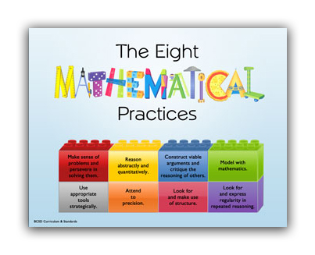
Standards for Mathematical Practice
Notes:
Say: For the last hour before lunch, we will be looking at the Standards for Mathematical Practice and how they align with the use of Number Talks. Does anyone know where we can find this document?
<Show the teachers how to access the SMP document in Curriculum Engine, under “Document View. Click the picture as it links to CE.>
(2 min.)

Slide 25

JIGSAW
Notes:
Say: In order to take a closer look at the 8 Standards for Mathematical Practice, we are going to assign each of you a standard to become an “expert” on. You will work with a team to read about your standard and create an anchor chart to display pertinent information. This is called the “Jigsaw” strategy and it can be used to section of different parts of text (usually non-fiction) for students to work cooperatively to read, understand, and teach their classmates.
<Pass out Standards for Mathematical Practice documents to each person. Number off staff 1-8 and assign them their standard. Teachers will work together to create an anchor chart.>
Circulate and assist. After about 10 minutes, begin sharing whole group.
(Roughly 35 – 40 minutes for entire activity.)

Slide 26

Get2mathk-5
Notes:
Say: Before we have you complete your “exit ticket” today, we wanted to show you a very valuable website called “Get 2 Math K-5.”
<click on picture to link to website>
Presenter will show the valuable resources for teachers on the website.

Slide 27
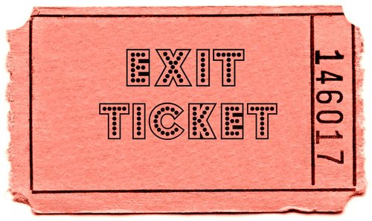
Changes?
Notes:
Say: Your exit ticket before lunch is to consider what changes you might make in your Math instruction based on the information you learned in today’s session covering number talks and the 8 standards for mathematical practice. Please jot your thoughts on the back of your “Number Talks Notes” page.
(2 min.)

Slide 28



